Slide 1
Rhone: Quality-Based Query Rewriting Algorithm for Data Integration
Daniel Aguiar da Silva Carvalho, Magellan, IAE, Univ. J. Moulin Lyon 3, France
Plácido Antonio de Souza Neto, DIATINF, IFRN, Brazil
Chirine Ghedira-Guegan, Magellan, IAE, Univ. J. Moulin Lyon 3, France
Nadia Bennani, LIRIS-CNRS, INSA-Lyon, Univ. Lyon, France
Genoveva Vargas-Solar, CRNS, LIG-LAFMIA, France
Notes:
Good morning, I am Daniel Aguiar from the Jean Moulin University, Lyon ,France…
and today I will present our work on designing a quality-based rewriting algorithm for data integration, called Rhone.

Slide 2
Agenda
Data integration from services
Rhone Service-Based Query Rewriting Algorithm
Principle & example
Experimental validation
Lessons learned
Notes:
This presentation is organized in three parts.
I will begin by introducing the context of our work which is data integration from services. I will precise our vision about data integration and the general principles of our approach.
Then i will introduce our algorithm query rewriting algorithm named Rhone.
I will explain the general principle focusing on the original aspects illustrated with examples.
I will also talk about the way we designed its experimental validation and which aspects we measured
- Finally I will conclude with lessons learned

Slide 3
Data integration: existing work
Data integration: the teenage years. Halevy, A., Rajaraman, A., & Ordille, J. (VLDB 2006, September)
Result
Query
Global
schema
Query rewriting
Mediator
Schema integration: Past, present, and future (Ram, S., & Ramesh, V. 1999)
MiniCon algorithm for query rewriting (Pottinger and Halevy, 2001)
Pivot data model & query language
(GaV, LaV, ontologies)
Exported schemata
Data integration architectures:
Multi-databases, federations, DW, …
(Domenig & Dittrich 1999 Sigmod Record]
Data
source A
Data
source B
Data
source C
Heterogeneous data sources known in advance
Notes:
The very classic vision of data integration is defined as fallows:
Given a set of heterogeneous data sources known in advance, provide solutions for retrieving data and answering queries
This problem is well known in the database domain It has been declined into many cases and associated results have been proposed.
For example,
the case where data sources share or not the same data model leading to works that reasoned about data models equivalence and transformation,
2. The case when they export or not schemata describing their content and whether a global schema is derived
3. The case where only a pivot model and language exist and queries must explicitly express which data from which sources to retrieve.
This cases lead to plenty of important results that I will not detail here for time reasons.

Slide 4
Data integration: existing work
Services lookup and matching
Result
Query
[1] Paolucci, M., Kawamura, T., Payne, T. R., & Sycara, K. (2002, June). Semantic matching of web services capabilities. In International Semantic Web Conference (pp. 333-347). Springer Berlin Heidelberg.
[2} Bramantoro, A., Krishnaswamy, S., & Indrawan, M. (2005, November). A semantic distance measure for matching web services. In International Conference on Web Information Systems Engineering (pp. 217-226). Springer Berlin Heidelberg.
[3} APA Maximilien, E. M., & Singh, M. P. (2004, November). Toward autonomic web services trust and selection. In Proceedings of the 2nd international conference on Service oriented computing (pp. 212-221). ACM.
Mediator
Query rewriting techniques
adapted to service composition
Exported API
[2] Barhamgi, M., Benslimane, D., and Medjahed, B. (2010). A query rewriting approach for web service composition. IEEE T. Services Computing, 3(3):206–222.
[3] da Costa, U. S., Alves, M. H. F., Musicante, M. A., and Robert, S. (2013). Automatic refinement of service compositions. In Daniel, F., Dolog, P., and Li, Q., editors, ICWE, volume 7977 of Lecture Notes in Com- puter Science, pages 400–407. Springer.
[4] Zhao, W., Liu, C., and Chen, J. (2011). Automatic compo- sition of information-providing web services based on query rewriting. Science China Information Sciences, pages 1–17.
. . .
Distributed data services
Notes:
The emergence of data services changed the data integration problem. Particularly, the hypothesis that assumed that data sources were known in advance.
The data integration problem in the presence of services as data providers redefined the problem as follows: Given a query expressing data requirements, look up data services that can fulfill those requirements. The assumptions were that services exported their API and that they can export data under a pivot model that can be used for integrating results.
Click
The query rewriting problem was redefined as a matching and a service composition problem and has led to fruitful results on query rewriting and service mathcing.

Slide 5



Data integration from data services
SLA
SLA
Availabity > 99,9%
Price per call = 0,5$
SLA
Data provider A: infected patient
Data provider C: Personal information
Availabity > 97%
Price per call = 0,1$
Availabity > 98%
Price per call = 0,3$
Data provider B: DNA information
Notes:
Consider the following example consisting of services that provide biological data to Health professionals
… data provider A provides information about infected patients
… data provider B provides DNA information
… data provider C provides personal information
Besides each provider exports its own Service Level Agreement specifying what a consumer can expect from its service…
In this example SLA’s define the availability and the price per call for each service. Thus data provider A is available 97% of the time and the price per call costs 0,15
Whereas data provider C is 99,9% of the time available and the price per call is 0,5 cents

Slide 6

Data integration from data services
SLA
Consumer
SLA
Availabity > 99,9%
Price per call = 0,5$
Retrieve personal and DNA information from patients that were infected by flu, using services with availability higher than 98%, price per call less than 0.2$ & total cost less than 5$
SLA
Data provider A: infected patient
Data provider C: Personal information
Availabity > 97%
Price per call = 0,1$
Availabity > 98%
Price per call = 0,3$
Data provider B: DNA information
Notes:
A data consumer could define her data requirements with associated restrictions as follows
Retrieve personal and DNA information from patients that were infected by flu, using services
with availability higher than 98%, price per call less than 0.2$ & total cost less than 5$
In order to express the query the consumer has an abstract view of services and this abstract view has associated a list of possible
Concrete services definitions that the consumer does not need to know. Particularly because there can be a lot and it could be painful to manually choose them

Slide 7
Abstract service & quality measures
SLA
Consumer
SLA
Availabity > 99,9%
Price per call = 0,5$
S1 (a?; b!) := A1 (a?; b!) [availability > 98%, price per call = 0,2$]
S2 (a?; b!) := A1 (a?; b!) [availability > 98%, price per call = 0,1$]
S3 (a?; b!) := A2 (a?; b!) [availability > 99%, price per call = 0,1$]
S4 (a?; b!) := A1 (a?; p!), A2 (p?; b!) [availability > 98%, price per call = 0,1$]
S5 (a?; b!) := A3 (a?; b!) [availability > 98%, price per call = 0,0$]
S6 (a?; b!, c!) := A1 (a?; p!), A2 (p?; b!), A3 (p?; c!) [availability > 99%, price per call = 0,2$]
S7 (a?; b!) := A4 (a?; b!) [availability > 99%, price per call = 0,2$]
SLA
Data provider A: infected patient
Data provider C: Personal information
Availabity > 97%
Price per call = 0,1$
Availabity > 98%
Price per call = 0,3$
Data provider B: DNA information
Notes:
We use the following declarative expressions for formally describing this abstract – concrete services association
In our example, given these 7 concrete services, the abstract service A1 returns infected patients given a disease, A2 returns the DNA information and A3 the patient personal information… between brackets we can also see the quality features associated to each concrete service

Slide 8
Query with associated preferences
SLA
SLA
Retrieve personal and DNA information from patients that were infected by flu, using services with availability higher than 98%, price per call less than 0.2$ & total cost less than 5$
Q(dis?; dna!, info!) :=
A1 (dis?; p!), A2 (p?; dna!), A3 (p?; info!),
dis= “flu” , [availability > 99%, price per call < 0,2$, total cost < 5$]
Data provider A: infected patient
Data provider C: Personal information
S1 (a?; b!) := A1 (a?; b!) [availability > 98%, price per call = 0,2$]
S2 (a?; b!) := A1 (a?; b!) [availability > 98%, price per call = 0,1$]
SLA
S5 (a?; b!) := A3 (a?; b!) [availability > 98%, price per call = 0,0$]
S6 (a?; b!, c!) := A1 (a?; p!), A2 (p?; b!), A3 (p?; c!) [availability > 99%, price per call = 0,2$]
S7 (a?; b!) := A4 (a?; b!) [availability > 99%, price per call = 0,2$]
Data provider B: DNA information
S3 (a?; b!) := A2 (a?; b!) [availability > 99%, price per call = 0,1$]
S4 (a?; b!) := A1 (a?; p!), A2 (p?; b!) [availability > 98%, price per call = 0,1$]
Notes:
Similarly, the query can be also expressed in terms of abstract services and it user preferences can be associated to them
For instance, our previous query example can be expressed in the following datalog like manner:
The left-side is called the head and the right-side is the body. In the head definition, there are a set of comma-separated input variables (identified by the question mark) and output variables (identified by exclamation mark). These variables are called head variables and they can be used by any abstract service in the body definition. In the body definition, the query is expressed as a sequence of abstract services, a set of constraints and user preferences. Abstract services (such as A1, A2 and A3) also have input and output variables. Variables that appear only in abstract services are called local variables (such as ‘p’). ‘Dis’ is a constraint used while executing the query. Between brackets are the user preferences.

Slide 9
Combining services for answering queries
Q(dis?; dna!, info!) := A1 (dis?; p!), A2 (p?; dna!), A3 (p?; info!), d= “flu , [ availability > 99%, price per call < 0,2$, total cost < 5$]
S1, S3, S5
S2, S3, S5
S4, S5
S6
Data provider A: infected patient
Data provider C: Personal information
S1 (a?; b!) := A1 (a?; b!) [availability > 98%, price per call = 0,2$]
S2 (a?; b!) := A1 (a?; b!) [availability > 98%, price per call = 0,1$]
S5 (a?; b!) := A3 (a?; b!) [availability > 98%, price per call = 0,0$]
S6 (a?; b!, c!) := A1 (a?; p!), A2 (p?; b!), A3 (p?; c!) [availability > 99%, price per call = 0,2$]
S7 (a?; b!) := A4 (a?; b!) [availability > 99%, price per call = 0,2$]
Data provider B: DNA information
S3 (a?; b!) := A2 (a?; b!) [availability > 99%, price per call = 0,1$]
S4 (a?; b!) := A1 (a?; p!), A2 (p?; b!) [availability > 98%, price per call = 0,1$]
Notes:
Given the query, the different concrete services can be combined in order to produce results. Such as composing:
...S1 (which retrieves infected patients), S3 (which retrieves DNA) and S5 (which retrieves personal information)
...S2 (which retrieves infected patients), S3 (which retrieves DNA) and S5 (which retrieves personal information)
...S4 (which retrieves infected patients and DNA) and S5 (which retrieves personal information) or
...S6 (which returns all desired data)
Here, it is interesting to highlight that a filtering process is necessary to guarantee that the user preferences and requirements are satisfied.

Slide 10
Vision
Data integration
A combinatorial problem where a query result is a data collection integrated by
composing different data providers
data processing (cloud) services
that fulfill quality constraints and SLAs specified by a data consumer
Notes:
Considering this context, in our vision, data integration deals with a combinatorial problem where a query result is a data collection integrated by composing different data providers and data processing (cloud) services that fulfill quality constraints and SLAs specified by a data consumer.

Slide 11
Objective
Guide the integration process explicitly considering
data providers quality &
infrastructure properties
(reliability, computing, storage & memory capacity, cost)
Notes:
In consequence, our objective is to guide the integration process explicitly considering data providers quality and infrastructure properties such as reliability, computing, storage and memory capacity, and cost.

Slide 12
Approach
Address data integration considering
data quality (freshness, provenance, cost, availability) properties &
service level agreements (SLA)
Hypothesis
the data integration process is totally or partially externalized on different clouds that provide necessary resources under different conditions (SLA)
data can be retrieved from several data providers (i.e., services) with different quality properties
Notes:
In orther to achieve our objective we propose to address data integration considering data quality (freshness, provenance, cost, availability) properties and service level agreements (SLA)
Assuming two important hypotesis:
First, the data integration process is totally or partially externalized on different clouds that provide necessary resources under different conditions (SLA)
and second data can be retrieved from several data providers (i.e., services) with different quality properties

Slide 13
Rhone Service-Based Query Rewriting Algorithm
Selecting candidate concrete services
Creating candidate service descriptions (CSD)
Combinig CSDs
Producing rewritings
A rewriting algorithm customizing
data providers (services) look up
data integration considering different data consumers requirements and expectations
requirements & expectations depend on the context in which they consume data (e.g., mobile devices with few physical capacities, critical decision making)
Notes:
We have proposed and designed a service-based query rewriting algorithm taking into account our approach and hypotesis.
It consists in 4 steps: including service matching and service combination ensuring that they fulfill quality requirements.
Our algorithm customizes:
The data providers services look up. The data integration considering different data consumers requirements and expectations
And the requirements and expectations depend on the context in which they consume data (e.g., mobile devices with few physical capacities, critical decision making)
In the following I briefly describe the general principle of the steps.

Slide 14
Rhone Service-Based Query Rewriting Algorithm
Abstract services
Concrete services
Query
Selecting candidate concrete services
Creating candidate service descriptions (CSD)
Combinig CSDs
Producing rewritings
Services are selected considering their characteristics (expressed in the SLAs)
Services that can produce results that are useless to the user query are discarded in the first step
Notes:
Given a set of abstract services, a set of concrete services and a query defined by the user as inputs
In the first step candidate concrete services are selected.
These services are selected considering their characteristics (expressed in the SLAs) and services that can produce results that are useless to the user query are discarded in the first step.

Slide 15
Concrete service matching
A query with preferences
A set of concrete services &
Choose those services that match data required with data produced
S1 (a?; b!) := A1 (a?; b!) [availability > 98%, price per call = 0,2$]
S2 (a?; b!) := A1 (a?; b!) [availability > 98%, price per call = 0,1$]
S3 (a?; b!) := A2 (a?; b!) [availability > 99%, price per call = 0,1$]
S4 (a?; b!) := A1 (a?; p!), A2 (p?; b!) [availability > 98%, price per call = 0,1$]
S5 (a?; b!) := A3 (a?; b!) [availability > 98%, price per call = 0,0$]
S6 (a?; b!, c!) := A1 (a?; p!), A2 (p?; b!), A3 (p?; c!) [availability > 99%, price per call = 0,2$]
S7 (a?; b!) := A4 (a?; b!) [availability > 99%, price per call = 0,2$]
Q(dis?; dna!, info!) :=
A1 (dis?; p!), A2 (p?; dna!), A3 (p?; info!),
d= “flu”, [ availability > 98%, price per call < 0,2$, total cost < 5$]
Notes:
While selecting candidate concrete services we deal with a concrete service matching.
For instance, in this step considering a query with preferences and a set of concrete services.
We have to choose those services that match data required with data produced.
Click
As you can see we select services that can produce a result for the user query.
And, consequently, the service S7 is discarded once it can not produce a result to the query.
Click

Slide 16
Matching quality features
A query with preferences
A set of concrete services that match data required with data produced
Choose services that match preferences
S1 (a?; b!) := A1 (a?; b!) [availability > 98%, price per call = 0,2$]
S2 (a?; b!) := A1 (a?; b!) [availability > 98%, price per call = 0,1$]
S3 (a?; b!) := A2 (a?; b!) [availability > 99%, price per call = 0,1$]
S4 (a?; b!) := A1 (a?; p!), A2 (p?; b!) [availability > 98%, price per call = 0,1$]
S5 (a?; b!) := A3 (a?; b!) [availability > 98%, price per call = 0,0$]
S6 (a?; b!, c!) := A1 (a?; p!), A2 (p?; b!), A3 (p?; c!) [availability > 99%, price per call = 0,2$]
S7 (a?; b!) := A4 (a?; b!) [availability > 99%, price per call = 0,2$]
Q(dis?; dna!, info!) :=
A1 (dis?; p!), A2 (p?; dna!), A3 (p?; info!),
d= “flu”, [ availability > 98%, price per call < 0,2$, total cost < 5$]
Notes:
we also deal with a matching of quality features according to the user preferences and requirements
In our example the quality feature “Price per call” guaranteed by the services S1 and S6 do not cover the user requirement. Thus, they are discarded.
Once this process is finished we have a final list of candidate concrete services.

Slide 17
Rhone Service-Based Query Rewriting Algorithm
Abstract services
Concrete services
Query
Selecting candidate concrete services
Creating candidate service descriptions (CSD)
Combinig CSDs
Producing rewritings
Differently from the other algorithms, the mapping are created considering the concrete service definition and not each abstract service that compose it
Notes:
In the second step, the Rhone tries to build mapping from each concrete service to the query (These mapping are represented in a data structure that we call CSD).
Differently from the other algorithms, the mapping are created considering the concrete service definition and not each abstract service that compose it. This fact reduces the number of combination produced in the next step.

Slide 18
Rhone Service-Based Query Rewriting Algorithm
Abstract services
Concrete services
Query
Selecting candidate concrete services
Creating candidate service descriptions (CSD)
Combinig CSDs
Producing rewritings
Combinations are produced according to the part of the query that a given concrete service covers like the combinations in the Bucket algorithm
Notes:
In the third step,
The CSDs created are combined among them. Combinations are produced according to the part of the query that a given concrete service covers like the combinations in the Bucket algorithm.
This is the most expensive step in the algorithm depending on the size of the query and the number of CSDs

Slide 19
Matching & combining concrete services
CSD₂
Combinations
S2 (a?; b!) := A1 (a?; b!) [availability > 98%, price per call = 0,1$]
p₁ = { CSD₂ }
p₂ = { CSD₂ , CSD₃ }
p₃ = { CSD₂ , CSD₃ , CSD₅ }
CSD₃
S3 (a?; b!) := A2 (a?; b!) [availability > 99%, price per call = 0,1$]
S4 (a?; b!) := A1 (a?; p!), A2 (p?; b!) [availability > 98%, price per call = 0,1$]
CSD₅
S5 (a?; b!) := A3 (a?; b!) [availability > 98%, price per call = 0,0$]
Q(dis?; dna!, info!) :=
A1 (dis?; p!), A2 (p?; dna!), A3 (p?; info!),
dis= “flu”, [ availability > 98%,
price per call < 0,2$,
total cost < 5$]
19
Notes:
Considering our candidate concrete services, CSDs for S2, S3 and S5 are created.
A CSD for S4 cannot be created once the variables mapping is not possible.
Click
Given these 3 CSDs the combinations are produced taking into account the part of the query that it covers. In this case, 3 combiantions are generated.

Slide 20
Rhone Service-Based Query Rewriting Algorithm
Abstract services
Concrete services
Query
Selecting candidate concrete services
Creating candidate service descriptions (CSD)
Combinig CSDs
Producing rewritings
Differently from the other approaches, the rewritings are produced considering the user preferences and constraints, and the SLAs exported by the different data services.
Notes:
The last step ‘producing rewriting’ in which we have to check if the combination produced is a valid rewriting or not.
Click

Slide 21
Validating combinations
CSD₂
Combinations
S2 (a?; b!) := A1 (a?; b!) [availability > 98%, price per call = 0,1$]
p₁ = { CSD₂ }
p₂ = { CSD₂ , CSD₃ }
p₃ = { CSD₂ , CSD₃ , CSD₅ }
CSD₃
S3 (a?; b!) := A2 (a?; b!) [availability > 99%, price per call = 0,1$]
S4 (a?; b!) := A1 (a?; p!), A2 (p?; b!) [availability > 98%, price per call = 0,1$]
CSD₅
S5 (a?; b!) := A3 (a?; b!) [availability > 98%, price per call = 0,0$]
Q(dis?; dna!, info!) :=
A1 (dis?; p!), A2 (p?; dna!), A3 (p?; info!),
dis= “flu”, [ availability > 98%,
price per call < 0,2$,
total cost < 5$]
21
Notes:
Looking to the combination produced. We have to verify if they cover the entire query and exactly what the user expects.
Click
In this sense, only p3 is a valid rewrite of the query.

Slide 22
Experimental validation
The Rhone first version is implemented in Java
Evaluate the algorithm’s behavior
performance, quality and cost
Local environment simulating a mono-cloud
including a registry of 100 services
Two approaches compared
Traditional (without considering preferences and SLA) versus
Preference-guided (i.e., Rhone)
Notes:
We have performed experiments in order to validate our algorithm.
The first version is implemented in Java.
The idea behind the experiments is to evaluate the algorithm’s behavior.
To do so, the experiments were executed in a local environment including a service registry of 100 concrete services.
And we have compared two approaches: a traditional (without considering preferences and SLA) versus a preference-guided.

Slide 23
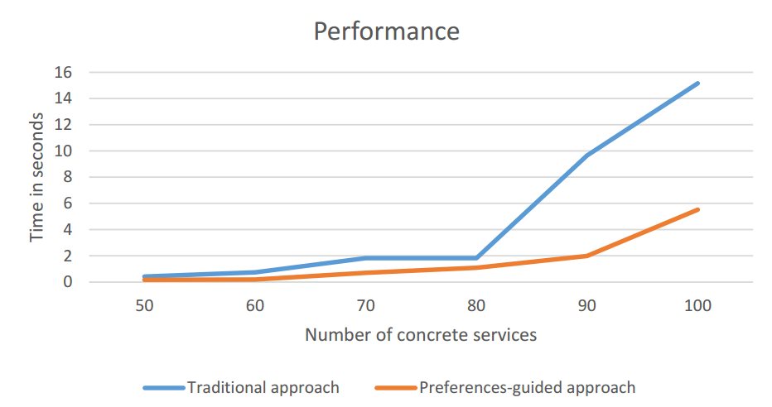
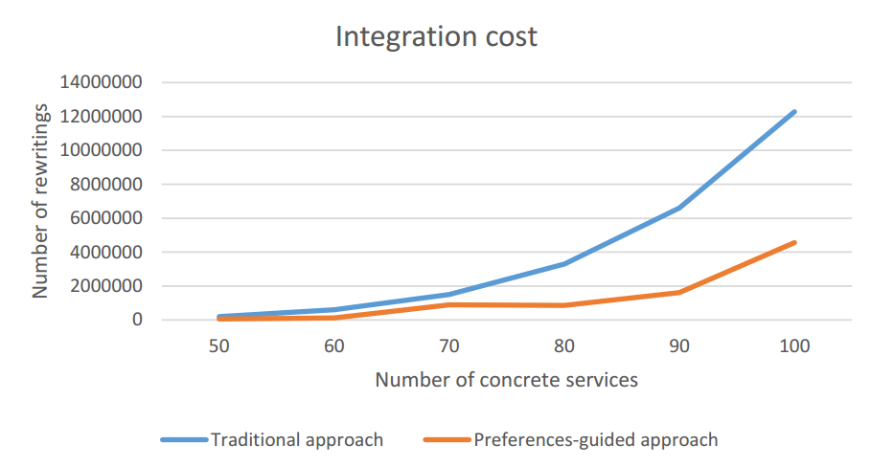
Lessons learned
Complexity
Selecting candidate concrete services: O (n²)
Creating candidate service descriptions: O (n³)
Combining CSDs: O (n^{k})^{m}
Producing rewritings: O (n)
Performance increased reducing
The number of rewriting solutions
Integration execution time
Rewriting solutions quality enhanced
Integration economic cost potentially reduced
Notes:
Based on the experimental validation, we can show you the Rhones’ profile
We can see the complexity of the different phases. As in the other algorithms, the most expensive step is the combination. It depends on the size of the query and the number of concrete service that could be mapped to the query.
The results of our experimental validation are illustrated by these two charts.
The performance increased by reducing the number of rewriting solutions and integration execution time. As we can see in the chart on the left.
Rewritring solutions quality enhanced and the integration economic cost is reduced once only rewriting that satisfies the user preferences are produced. As we can see in the chart on the right.
Click

Slide 24
Thank you for your attention!
Daniel Aguiar da Silva Carvalho,
Magellan, IAE, Univ. J. Moulin Lyon 3, France
Plácido Antonio de Souza Neto, DIATINF, IFRN, Brazil
Chirine Ghedira-Guegan, Magellan, IAE, Univ. J. Moulin Lyon 3, France
Nadia Bennani, LIRIS-CNRS, INSA-Lyon, Univ. Lyon, France
Genoveva Vargas-Solar, CRNS, LIG-LAFMIA, France
Notes:
And that’s the end of my speech. Thank you for your attention.

Slide 25
References
Ba, C., Costa, U., Halfeld-Ferrari, M., Ferre, R., Musicante, M.A., Peralta, V., Robert, S.: Preference-driven refinement of service compositions. In: International Conference on Cloud Computing and Services Science, Proceedings of CLOSER 2014 (2014)
Barhamgi, M., Benslimane, D., Medjahed, B.: A query rewriting approach for web service composition. IEEE Trans. Serv. Comput. 3, 206–222 (2010)
Bennani, N., Ghedira-Guegan, C., Musicante, M., Vargas-Solar, G.: Sla-guided data integration on cloud environments. In: 2014 IEEE 7th International Conference on Cloud Computing (CLOUD), pp. 934–935, June 2014
Benouaret, K., Benslimane, D., Hadjali, A., Barhamgi, M.: FuDoCS: a web service composition system based on fuzzy dominance for preference query answering. In: 37th International Conference on Very Large Data Bases (VLDB 2011)
Carvalho, D.A.S., Neto, P.A.S., Vargas-Solar, G., Bennani, N., Ghedira, C.: Can data integration quality be enhanced on multi-cloud using SLA? In: Chen, Q., Hameurlain, A., Toumani, F., Wagner, R., Decker, H. (eds.) DEXA 2015. LNCS, vol. 9262, pp. 145–152. Springer, Heidelberg (2015)
ElSheikh, G., ElNainay, M.Y., ElShehaby, S., Abougabal, M.S.: SODIM: service oriented data integration based on MapReduce. Alexandria Eng. J. 52, 313–318 (2013)
Halevy, A.Y.: Answering queries using views: a survey. VLDB J. 10(4), 270–294 (2001)
Tian, Y., Song, B., Park, J., Huh, E.-N.: Inter-cloud data integration system considering privacy and cost. In: Pan, J.-S., Chen, S.-M., Nguyen, N.T. (eds.) ICCCI2010, Part I. LNCS, vol. 6421, pp. 195–204. Springer, Heidelberg (2010)
Notes:
Here are the references we have used.
If you have any question I am here to answer it.

